Slide 1



The Power of Digital Signatures
The authenticity of many legal, financial, and other documents is traditionally verified by the presence of an authorized handwritten signature. However, the digital age has brought forth a revolutionary solution - the digital signature. This innovative technology not only ensures authenticity but also provides a secure and efficient way to conduct electronic transactions and communications.

Slide 2


What is a Digital Signature?
1
Hash Value Encryption
2
Verification with Public Key
A digital signature is the result of a complex mathematical process where the hash value of a message is encrypted using the signer's private key. This unique digital "fingerprint" represents the content of the document and the identity of the owner, ensuring authenticity.
The public key of the signer is made available to those who receive the signed messages. This allows the recipient to decrypt the digital signature and verify the message's integrity by comparing the decrypted hash value with the calculated hash of the received message.
3
Unique for Each Document
Since the digital signature varies from document to document, it ensures the authenticity of each word in the electronic document, providing an unparalleled level of security and trust.

Slide 3

Why Use Digital Signatures?
1
Authenticity
Digital signatures provide a reliable way to verify the identity of the signer and ensure the authenticity of electronic documents.
2
Integrity
Digital signatures protect the integrity of electronic documents by detecting any unauthorized modifications or tampering.
3
Non-repudiation
The use of digital signatures makes it impossible for the signer to deny their involvement in the creation or approval of a document, ensuring non-repudiation.
4
Secure e-Commerce and e-Governance
Digital signatures enable the safe and secure use of the internet for electronic commerce and electronic government transactions.

Slide 4
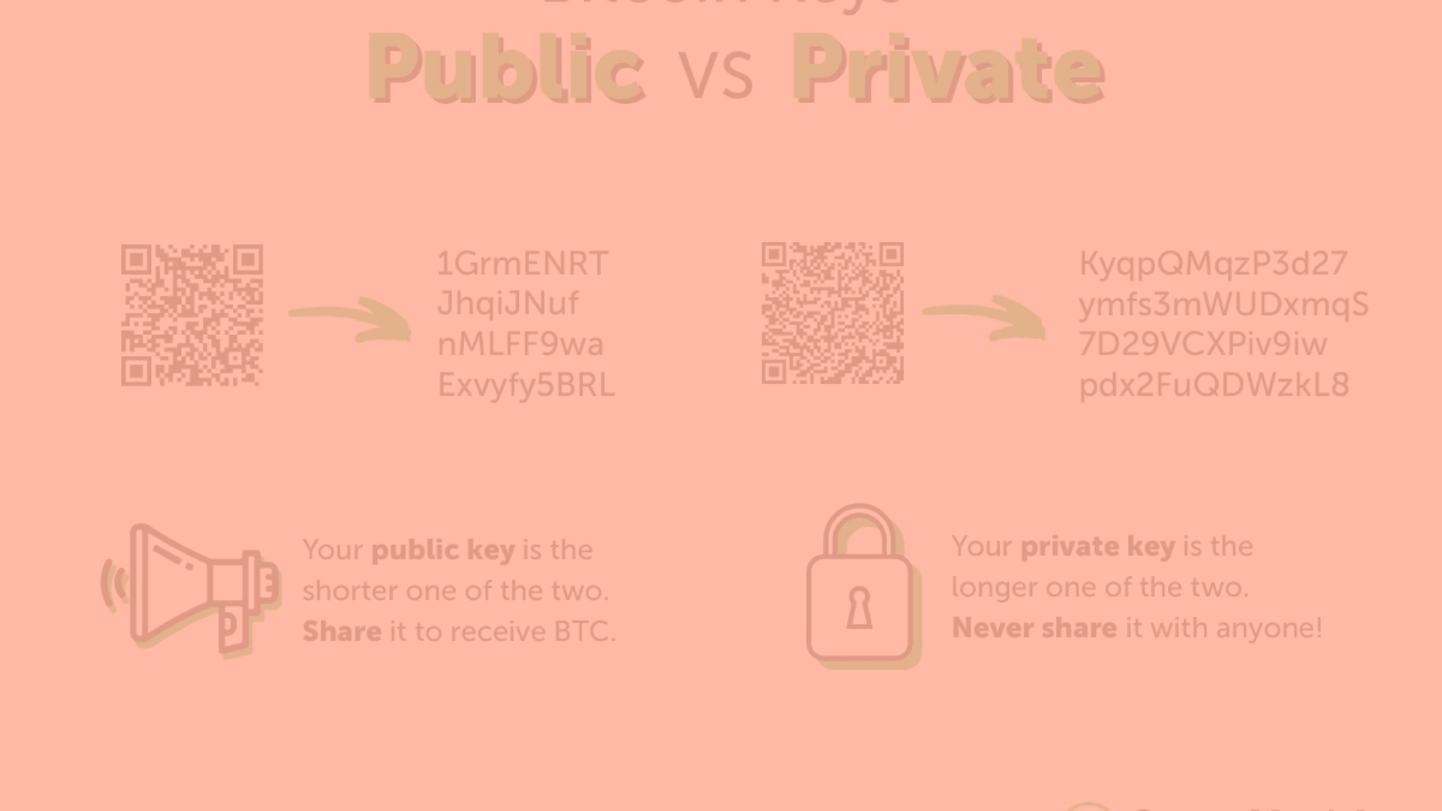
The Key Components
Public Key
Private Key
Digital Signature Certificate
The public key is made available to all those who receive the signed messages from the signer. It is used to verify the received message by decrypting the digital signature.
The private key is accessible only to the signer and is used to generate the digital signature, which is then attached to the message.
The digital signature certificate is issued by a trusted third-party entity, which allows the recipient of a message to prove that the message was indeed sent by the subscriber of the key pair.

Slide 5
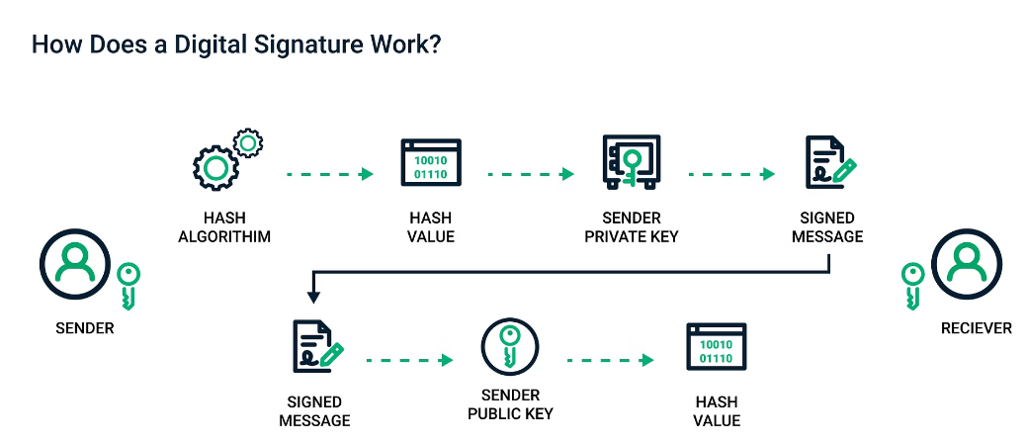
How Digital Signatures Work
1
2
3
Hash Calculation
Signature Creation
Signature Verification
The hash value of the file content or message is calculated by the signer's computer.
The hash value is encrypted with the signer's private key to create the digital signature.
The recipient's computer decrypts the digital signature using the signer's public key and compares the decrypted hash value with the calculated hash of the received message.

Slide 6




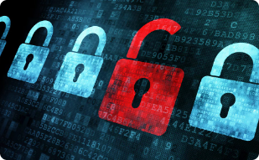
Potential Drawbacks
Technology Challenges
Security Concerns
Technology problems like website crashes or computer issues can sometimes interfere with the proper functioning of digital signatures.
Malicious actors may attempt to cheat the system or hack into it, leading to fraud or unauthorized use of digital signatures.
Usability Barriers
Long-term Security
Not everyone finds digital signatures easy to use, and some places may not accept them as valid signatures, causing legal problems.
Maintaining the security of digital signatures over a long period can be challenging as technology evolves, potentially compromising their long-term reliability.

Slide 7





Applications of Digital Signatures
Electronic Mail
Data Storage
Software Distribution
Smart Card Authentication
Digital signatures are used in email communication to ensure the authenticity and integrity of messages, verifying the sender's identity and preventing tampering.
Digital signatures are employed to secure data stored electronically, such as in databases, cloud storage, and file systems, ensuring the integrity of the data.
Digital signatures are utilized in software distribution to verify the authenticity and integrity of software packages and updates, protecting users from compromised software.
Digital signatures are integrated into smart card systems for secure authentication and access control, providing reliable identification for various applications.

Slide 8



Specialized Applications
Blind Signatures
ISDN Networks
Blind signatures are a specialized form of digital signature that allows a signer to sign a message without knowing its content, often used in privacy-sensitive applications like anonymous voting and digital cash systems.
In telecommunications, digital signatures can be used in ISDN networks to authenticate and secure data transmission between network endpoints, ensuring the integrity and confidentiality of voice, video, and data communication.

Slide 9
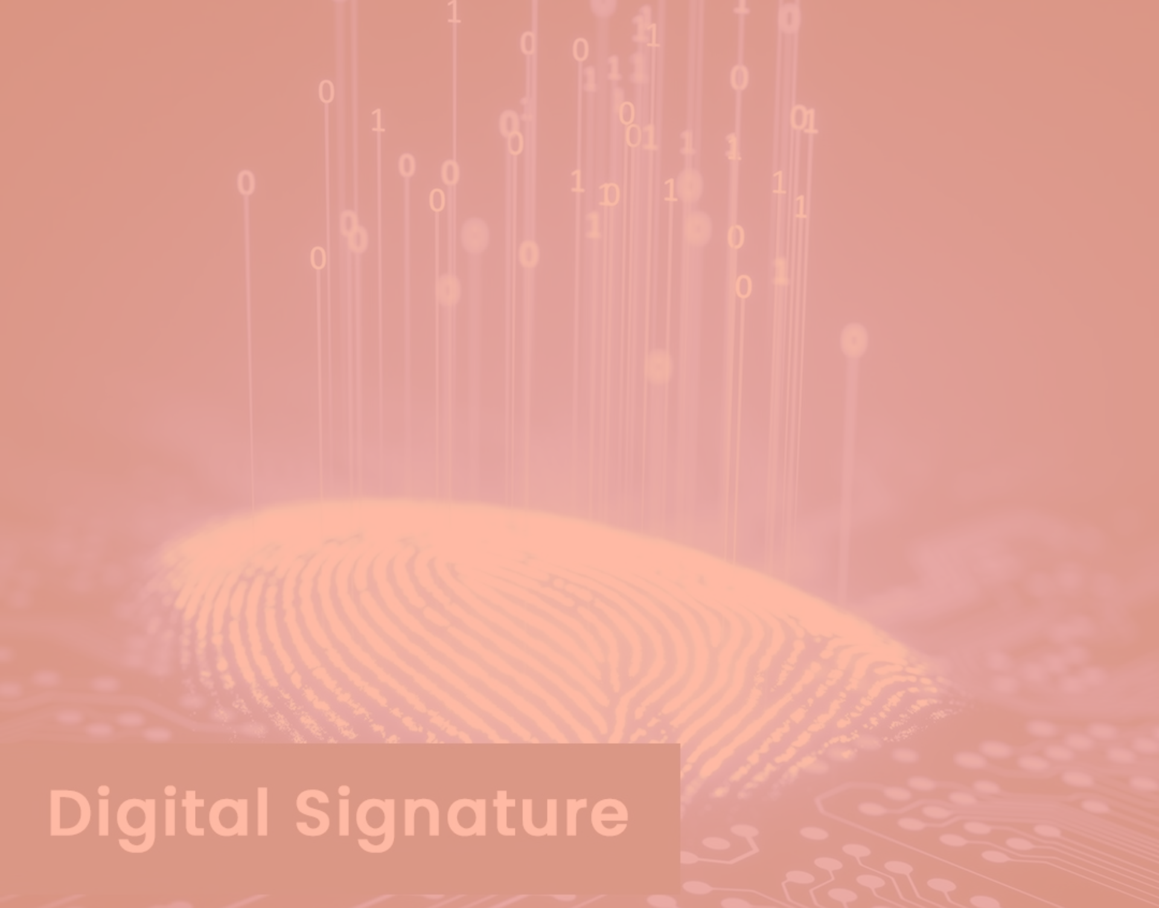
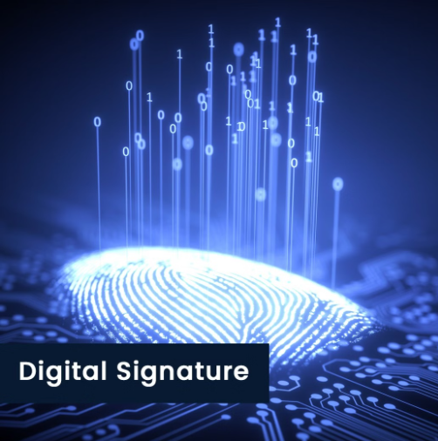
The Future of Digital Signatures
Evolving Security
1
As technology continues to advance, the security measures surrounding digital signatures will need to evolve to keep pace with emerging threats and vulnerabilities.
2
Increased Adoption
The widespread adoption of digital signatures is expected to continue, as they become more integrated into various industries and applications, providing a secure and efficient alternative to traditional handwritten signatures.
Regulatory Frameworks
3
Governments and regulatory bodies will play a crucial role in establishing clear guidelines and legal frameworks to ensure the proper use and acceptance of digital signatures, fostering trust and confidence in their implementation.

